Slide 1
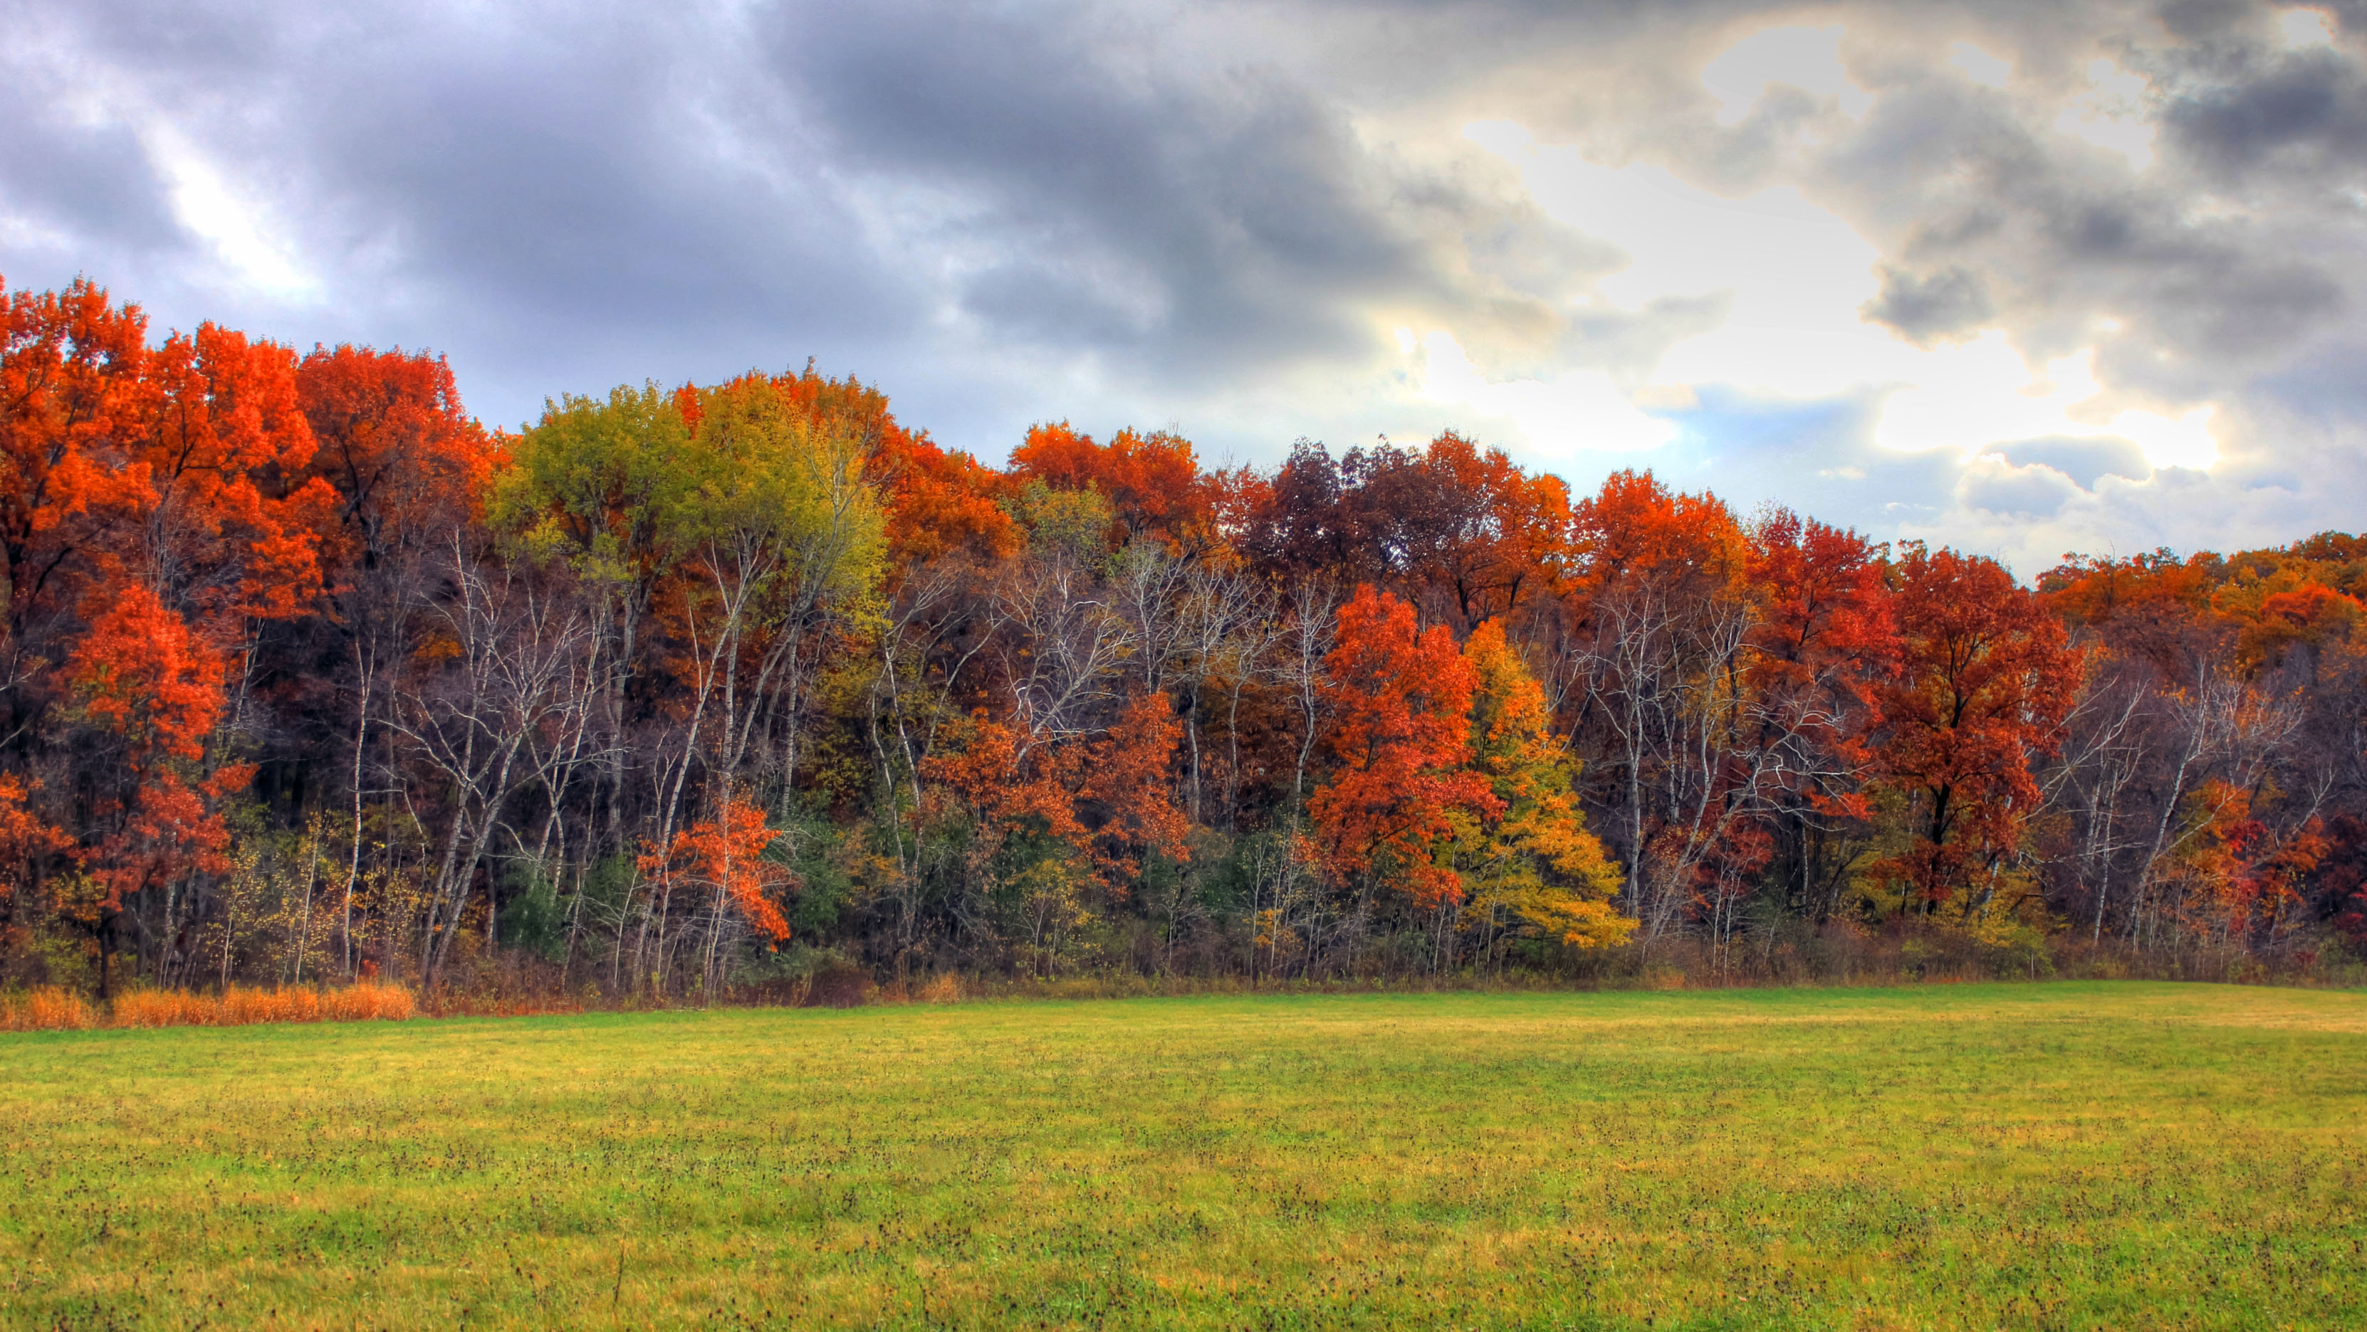
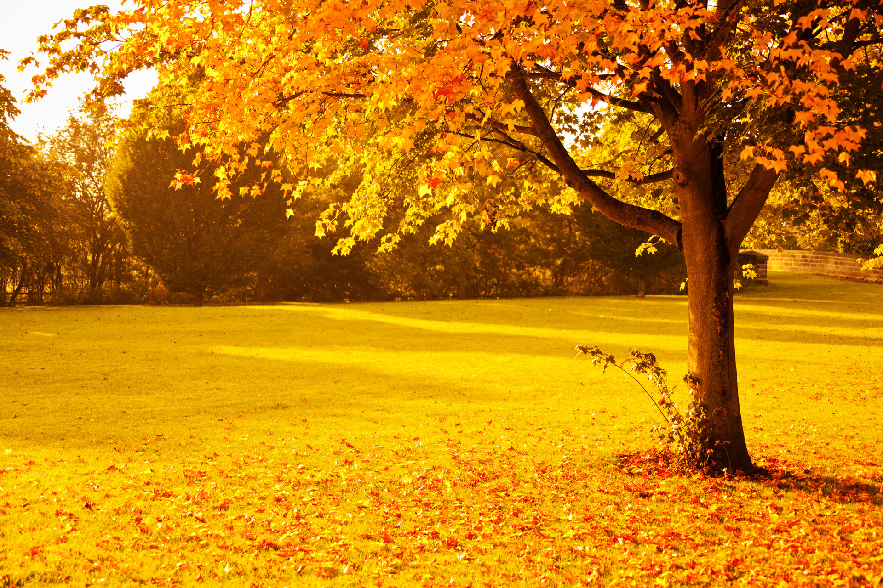
Forestry Part 2
2022 Envirothon Topic

Slide 2
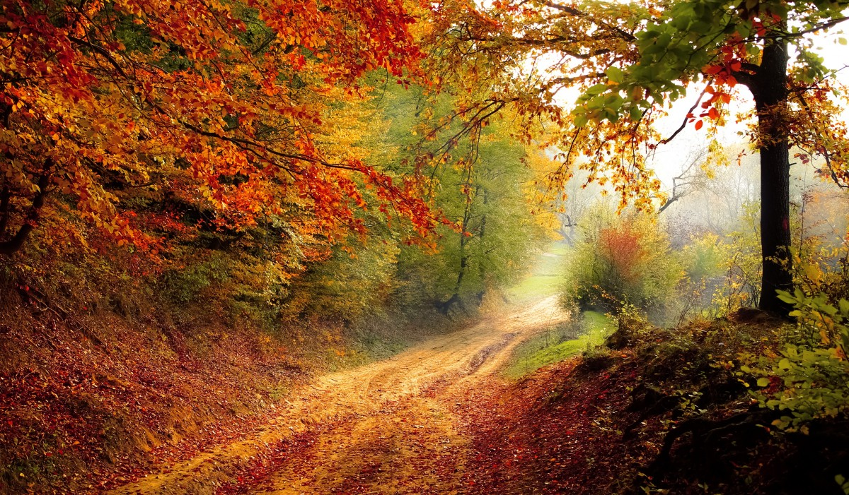
Last Forestry Lesson
Leaf types
Leaf Arrangements
Leaf Margins
Tree Growth Cycle
Environmental cause and effect
Soil Health in Forestry
Tree Rings (Dendrochronology)
Ten Important Hardwoods of PA and their uses

Slide 3
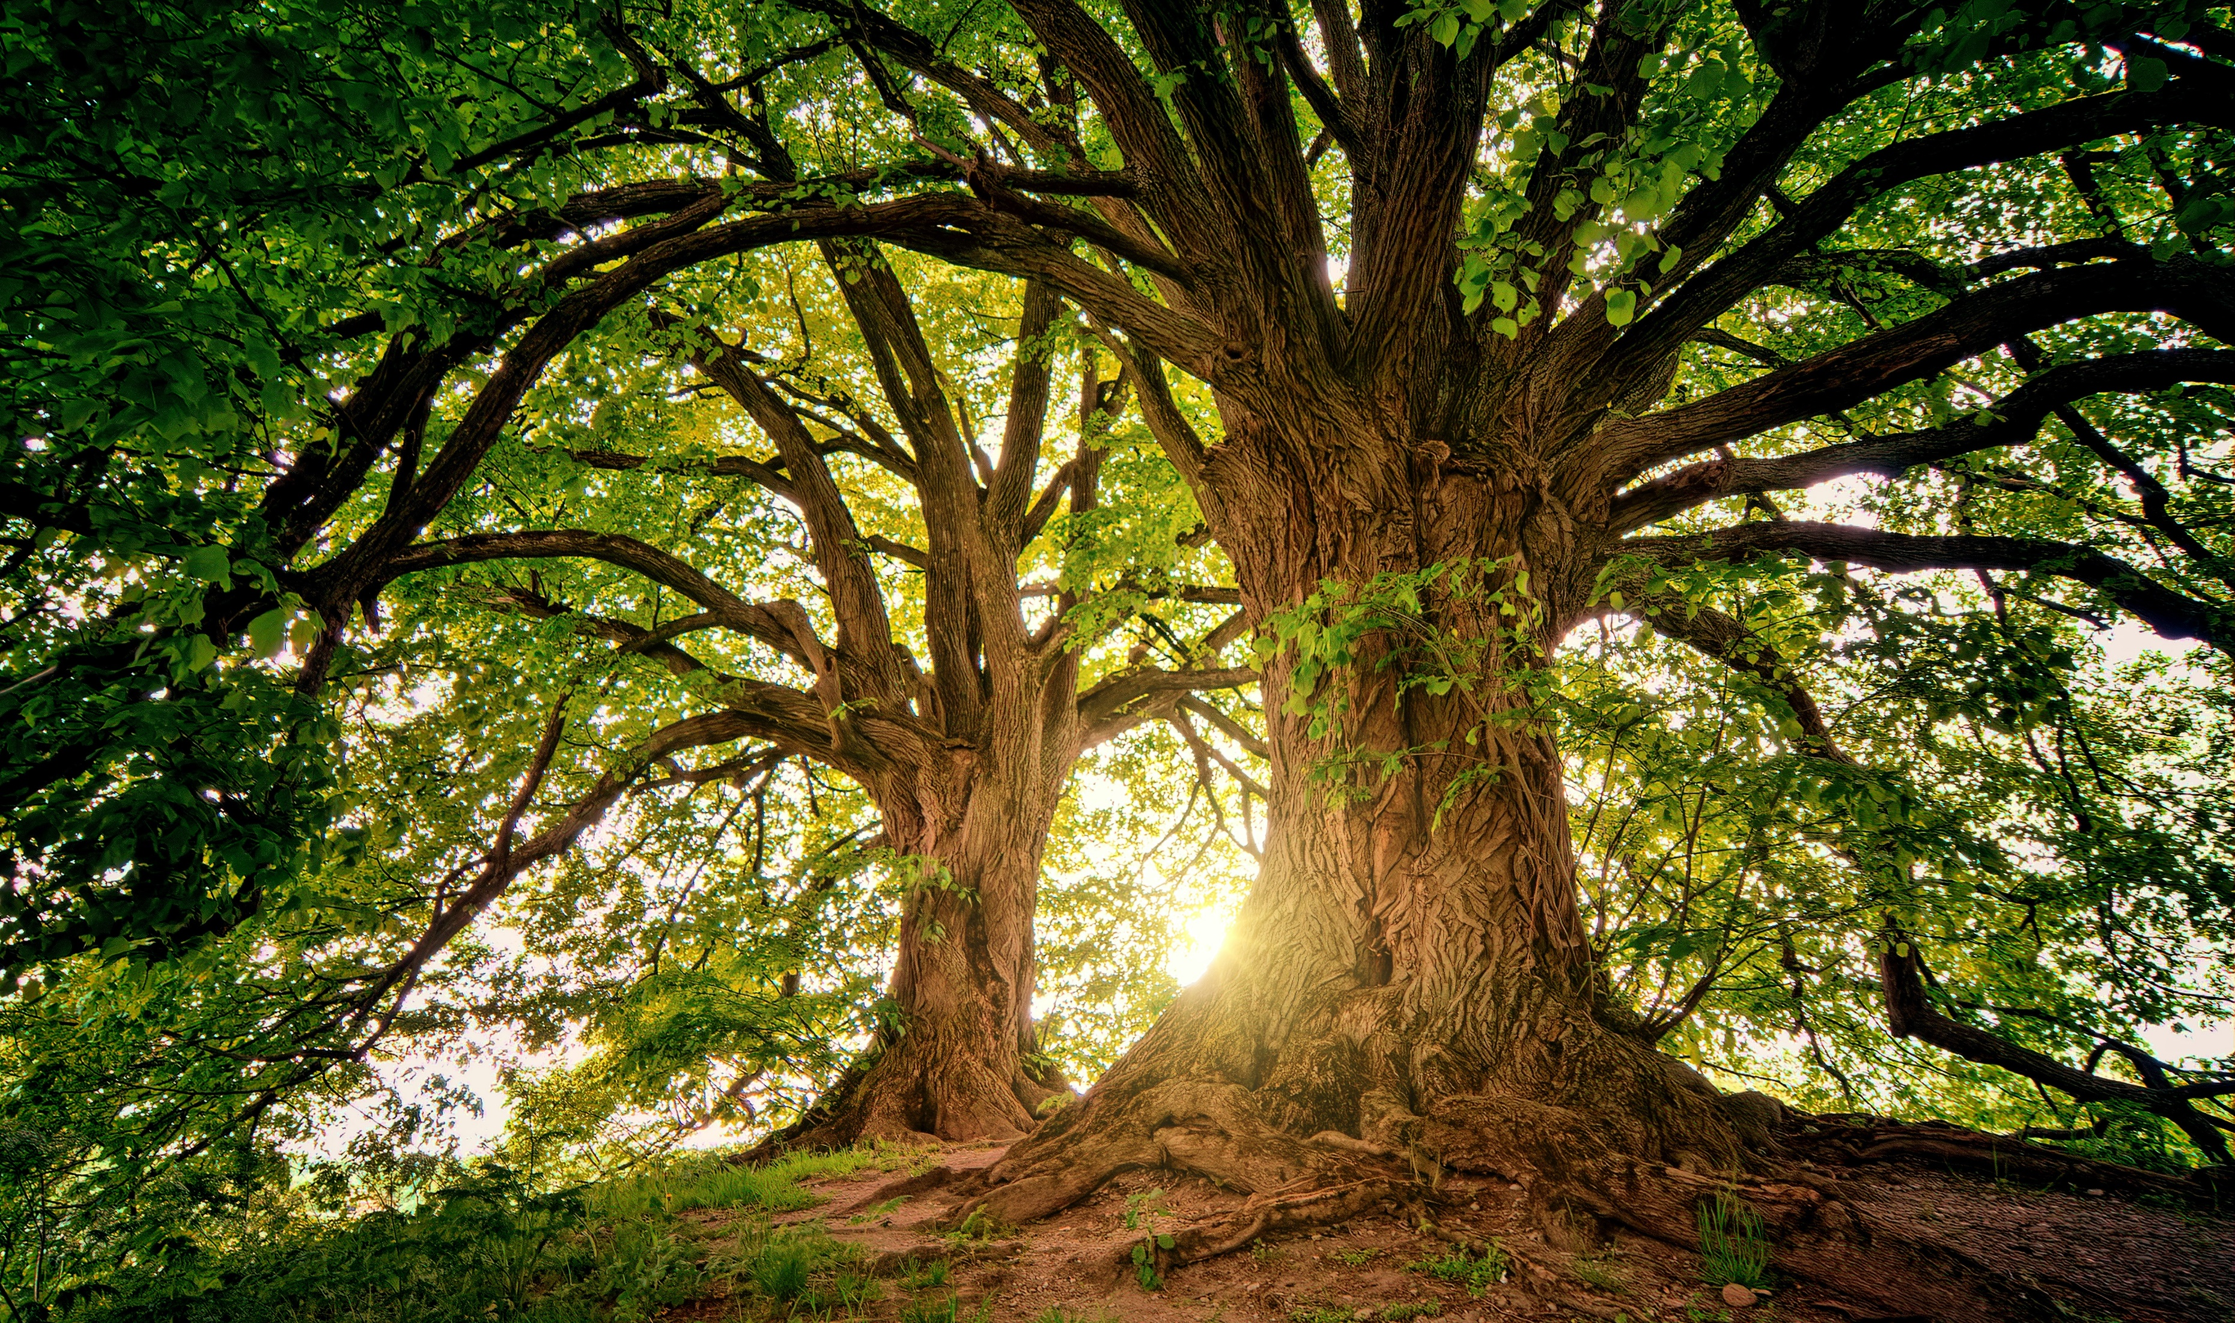
Today’s Topic Forest Ecology
Learning Objectives
Forest Types in PA based on Dominant Tree Species.
Typical Forest Succession
Forest as a Resource
Wildlife and Community

Slide 4
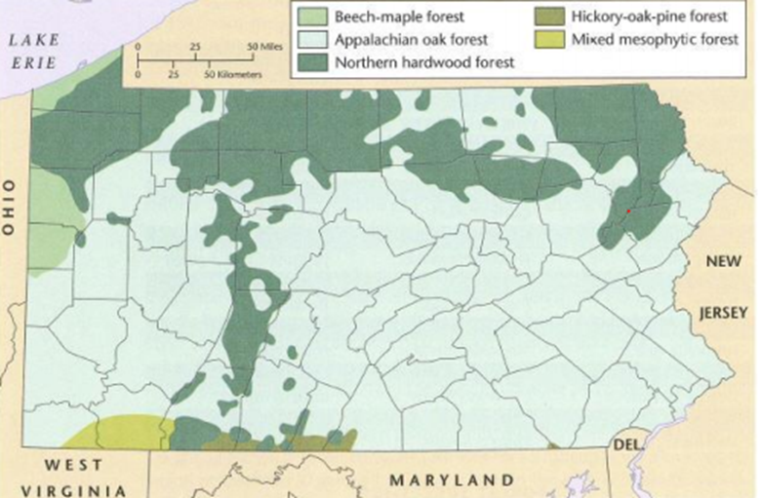
Major Types of Forest in PA
Northern Hardwood
Oak-hickory (Appalachian Oak forest)
Great Lakes Beech Maple
Mixed Mesophytic

Slide 5
Northern Hardwoods 32% of PA
Occupies the northern third of the state.
Mixture of hardwoods and conifers.
Conifers in this section include beech, birch, larch, sugar maple. Canadian hemlock and white pine.
American Larch- ONLY native deciduous conifer in PA.

Slide 6
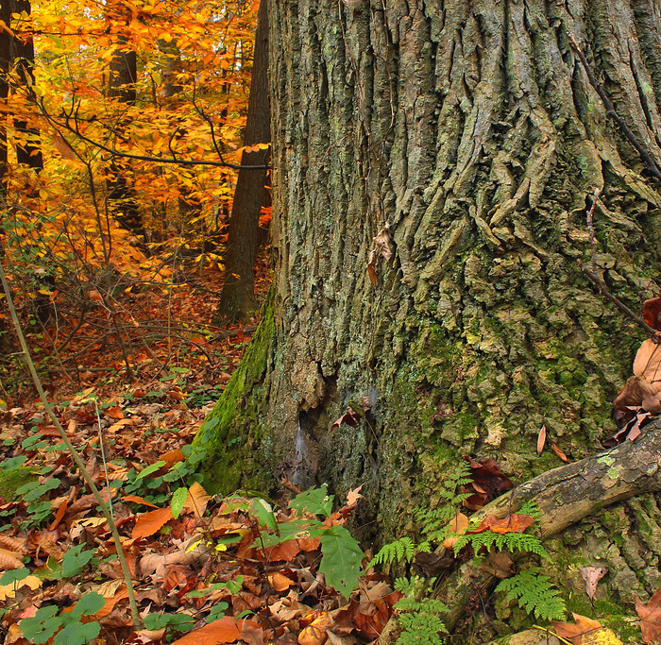
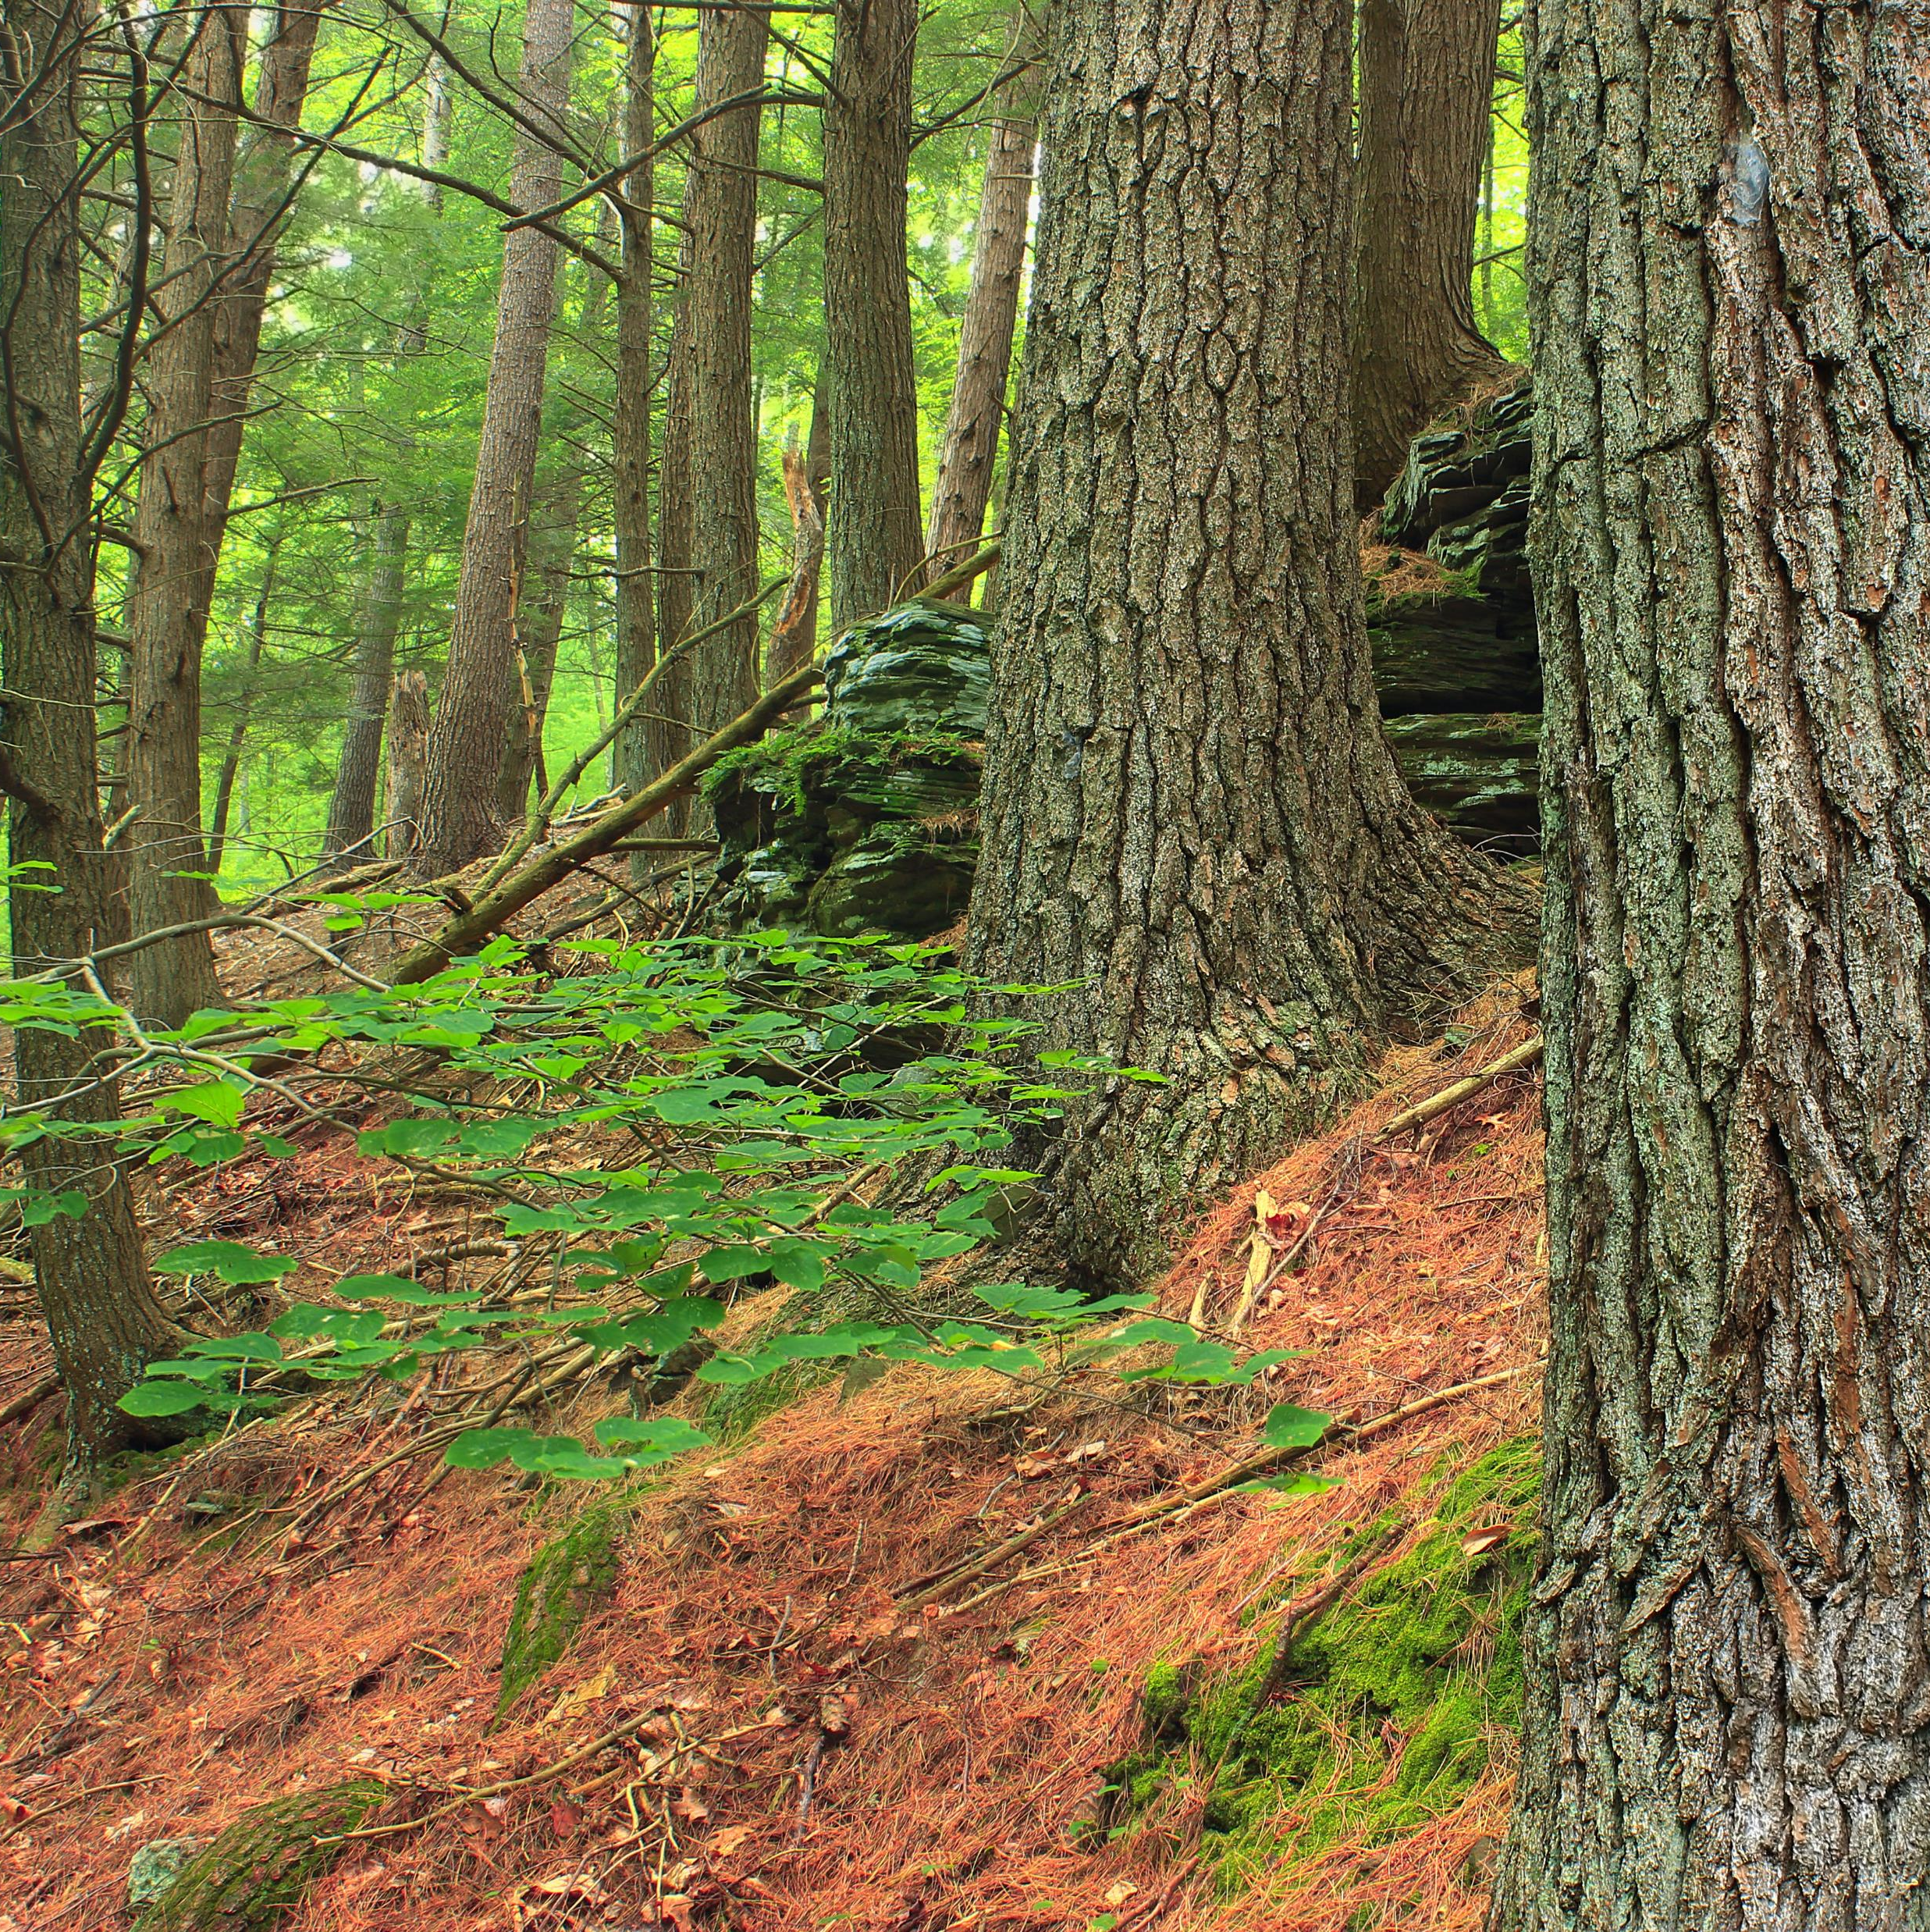
Oak Forest 52% / Mixed Oak of PA
Occupies Largest Range of PA.
Include mixed oak hardwood.
Typically, the Understory has dense shrubs; mountain laurel is most common.
Better in uplands, oaks especially Chestnut Oak not adapted to low riparian areas.
This Photo by Unknown Author is licensed under CC BY
This Photo by Unknown Author is licensed under CC BY

Slide 7
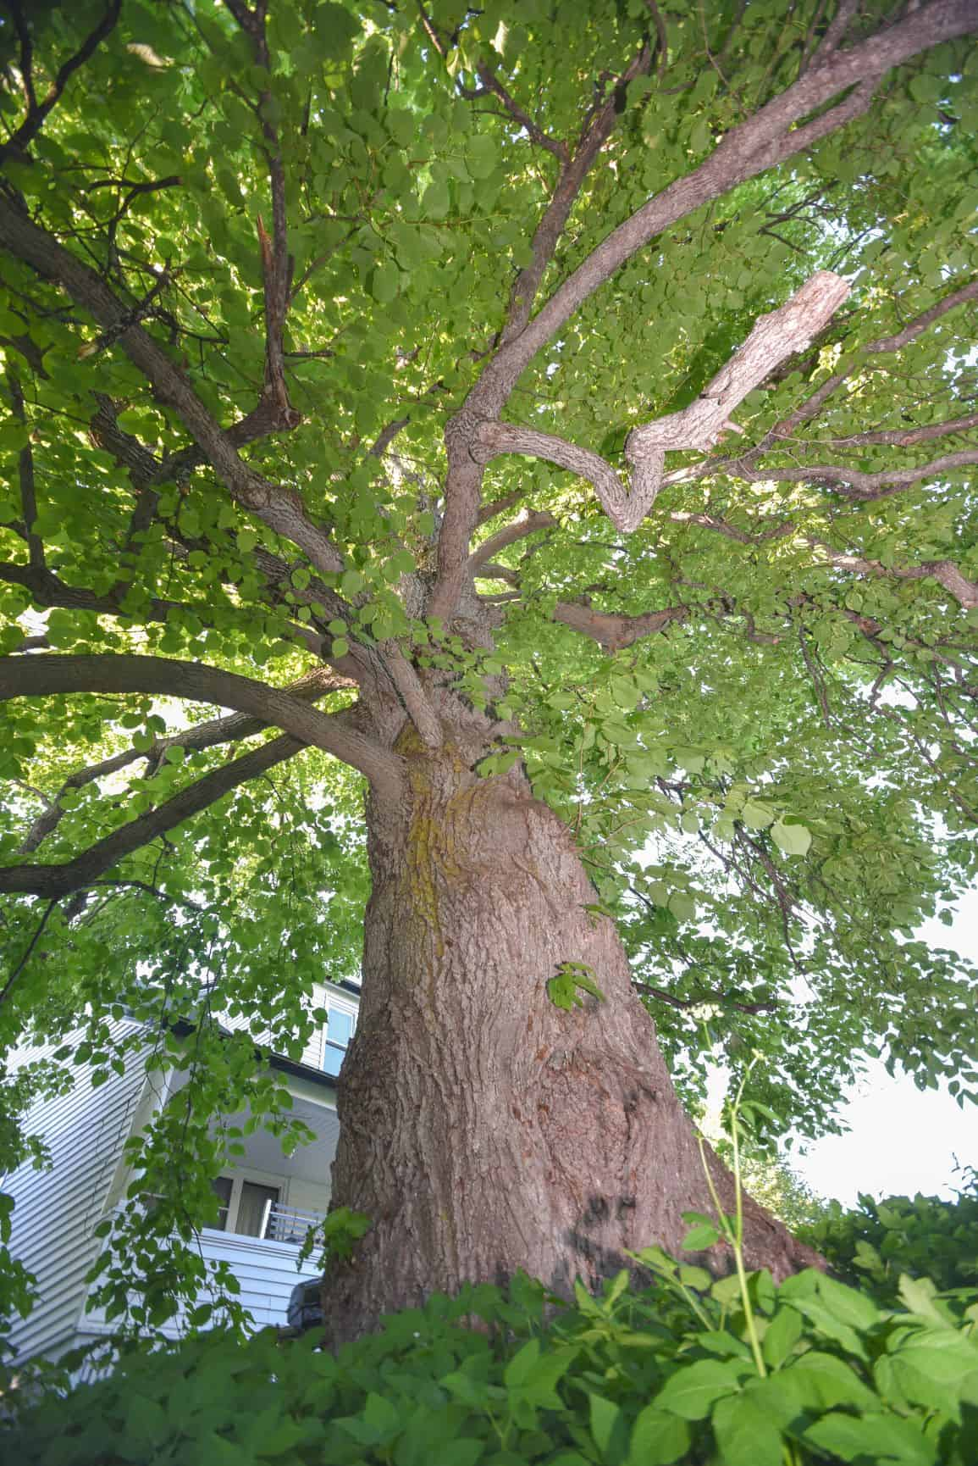
Great Lakes Beech Maple
Western end of state.
Sugar Maple is the STRONGEST Hardwood.
Tuliptree, Sugar Maple, beech, basswood, red oak, cucumber-tree, yellow buckeye, Ohio Buckeye, white ash, black cherry.
Understory contains flowering Dogwood, red bud, witch-hazel.
Herbaceous layer very dense and diverse.

Slide 8
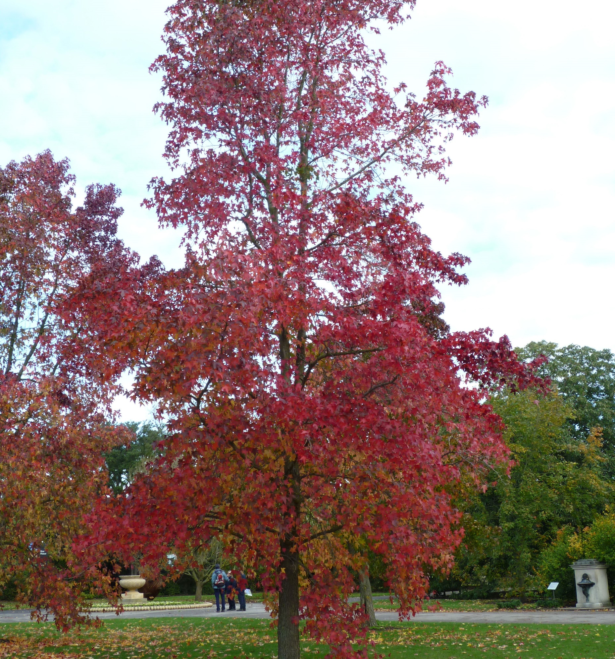
Mixed Mesophytic (Dryer climates)
Southern most region.
Atlantic coastal plain
Sweetgum, Willow Oak Southern Red oak.
This Photo by Unknown Author is licensed under CC BY-SA-NC

Slide 9
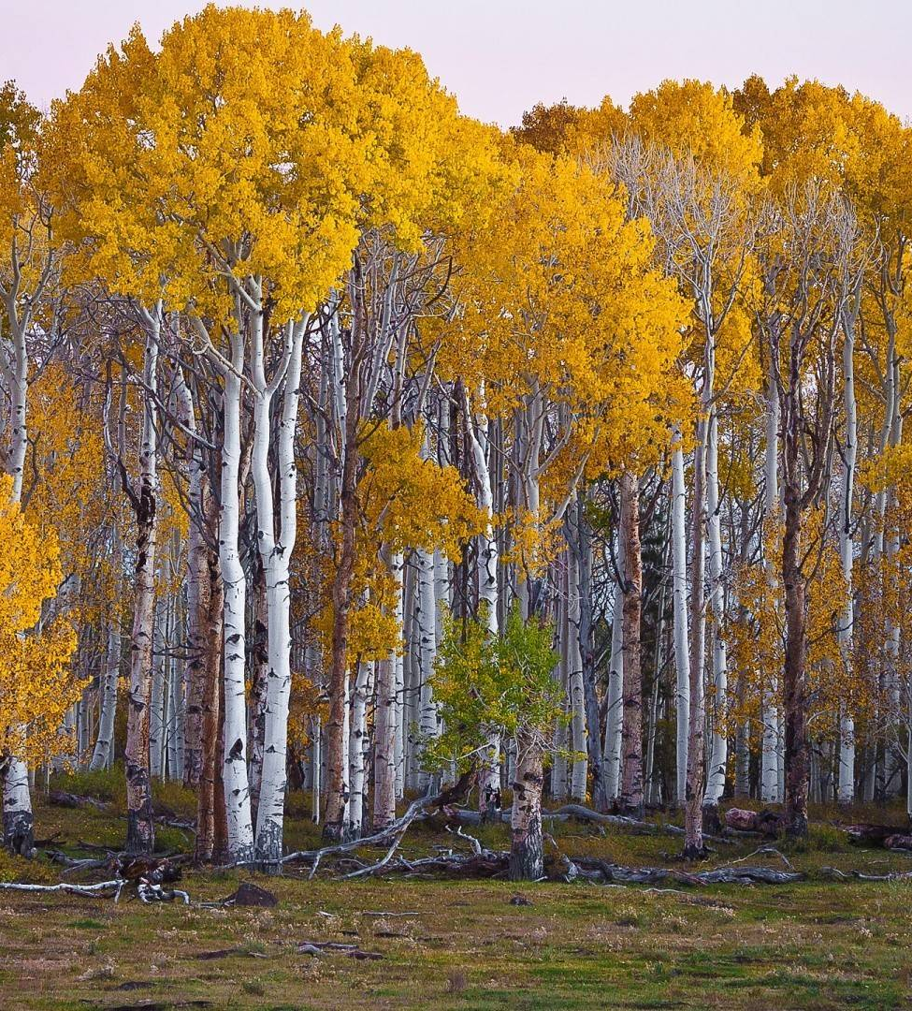
Forest Structure
Mosaic-Patterns
Mosaic Habitat- Each layer supports different wildlife.
Vertical Structure
Forest floor- blanketed with decaying material.
Herbaceous Layer- Dominated by soft stemmed plants such as grasses, ferns, wildflowers.
Shrub Layer- Woody vegetation growing close to ground. Mountain Laurel
Understory- immature trees, shorter than main canopy level. Takes advantage of canopy gaps.
Canopy Layer- crowns of most trees meet here to form a thick layer.
Emergent- Trees whose crowns grow above the normal canopy.
This Photo by Unknown Author is licensed under CC BY-SA

Slide 11
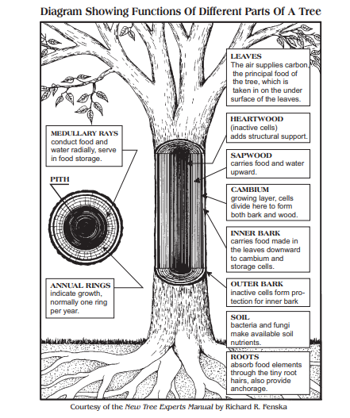
Parts of the Tree
Medullary Rays- Food Storage.
Annual Rings- Indicators of growth/ age.
Cambium- The Actively Growing Layer of Trunk.
Heartwood-Main structural support.
Basal- Cross section area of trunk used for measurements.

Slide 13
Wildlife and Succussion stages Where is PA?
Wildlife diversity can be related to stages in forest succession.
Generally, the “Pole Stage” Supports the Least Biodiversity.
Thanks to our understanding of this we know, PA Forest are generally stable, and PA forest are growing older

Slide 14
Threats to Forest Succession?
White Tail Deer. Scavenge and eat absolutely everything.
Invasive plant species. Take over ecosystems and suffocate native species development.
Invasive insects. Kill new vegetation and dominate natural insect chains.
Example, Species of oak such as the American Chestnut were wiped up due to invasion fungus.
This Photo by Unknown Author is licensed under CC BY-NC-ND

Slide 15
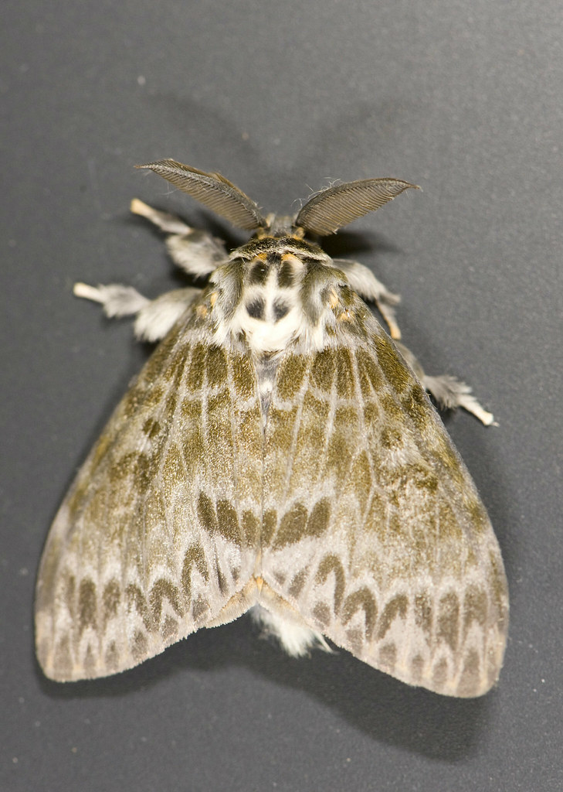
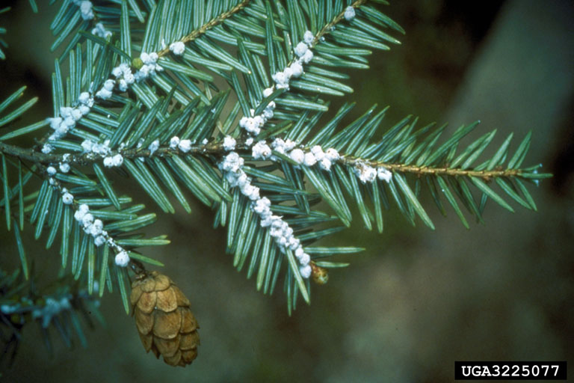
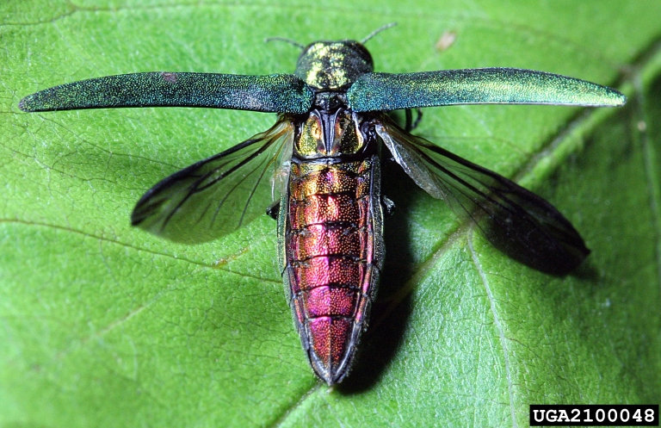
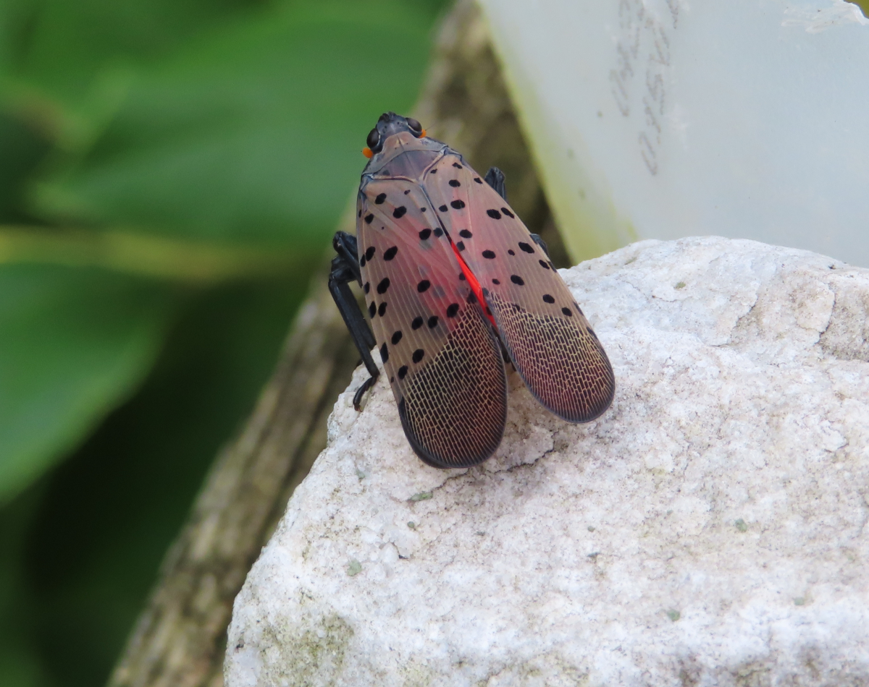
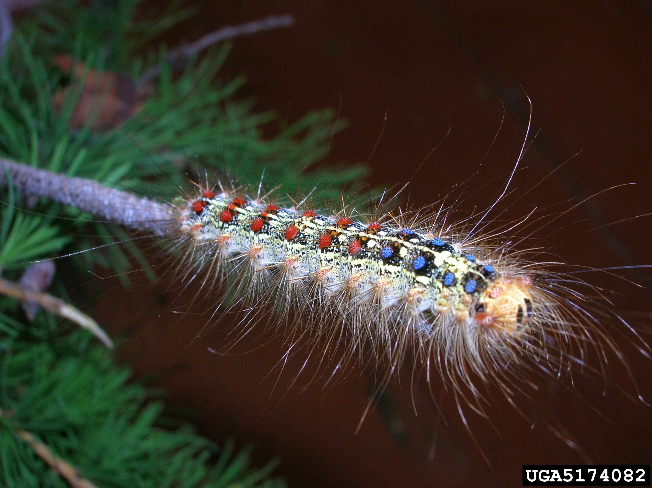
Risk to our Forest?
Invasive and Non-Native Insects
Wreak Havoc on forest ecosystems.
EXAMPLES
Spotted Lantern Fly
Gypsy moth (Spongy Moth)
Wooly Adelgid
Emerald Ash Bore

Slide 16
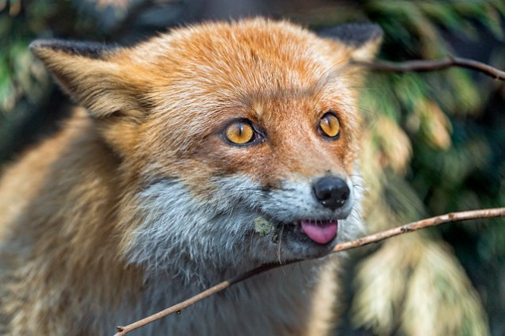
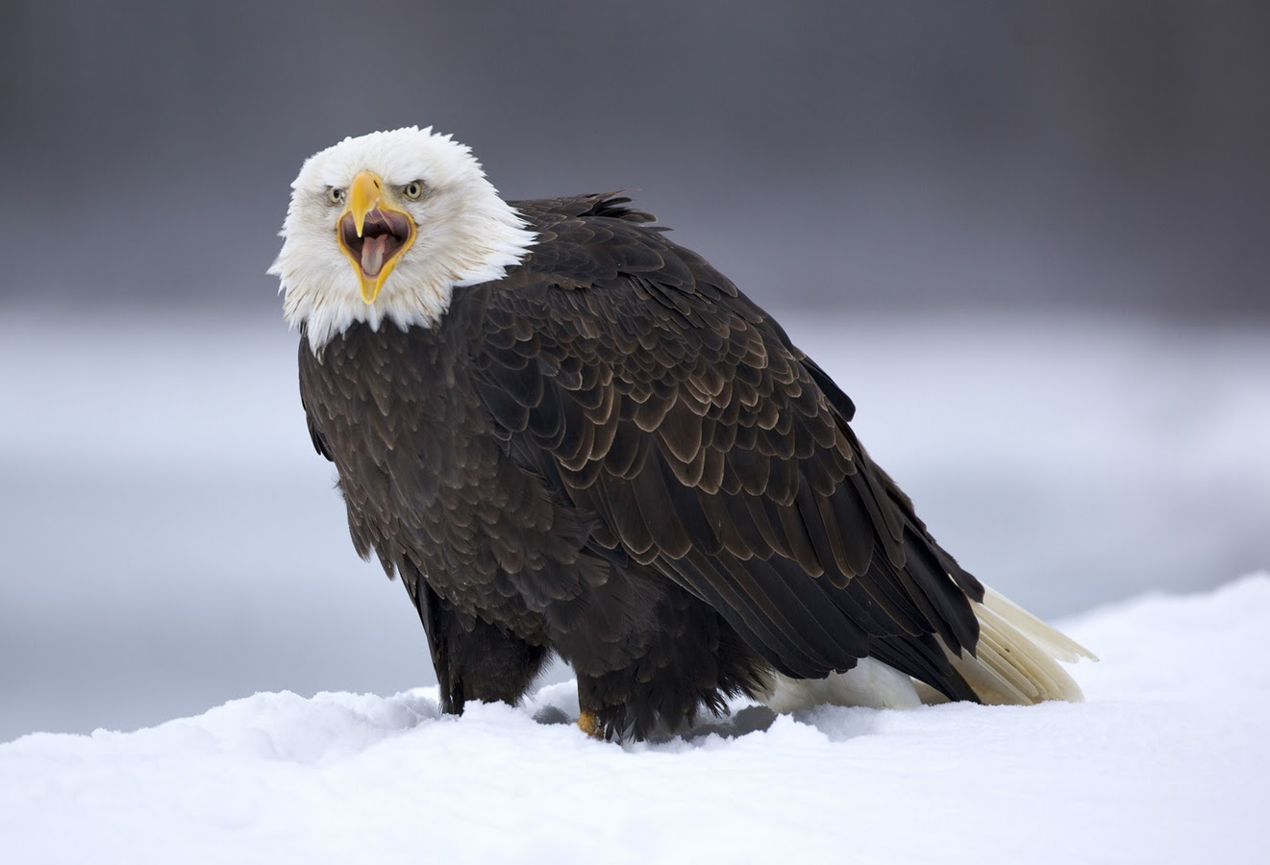
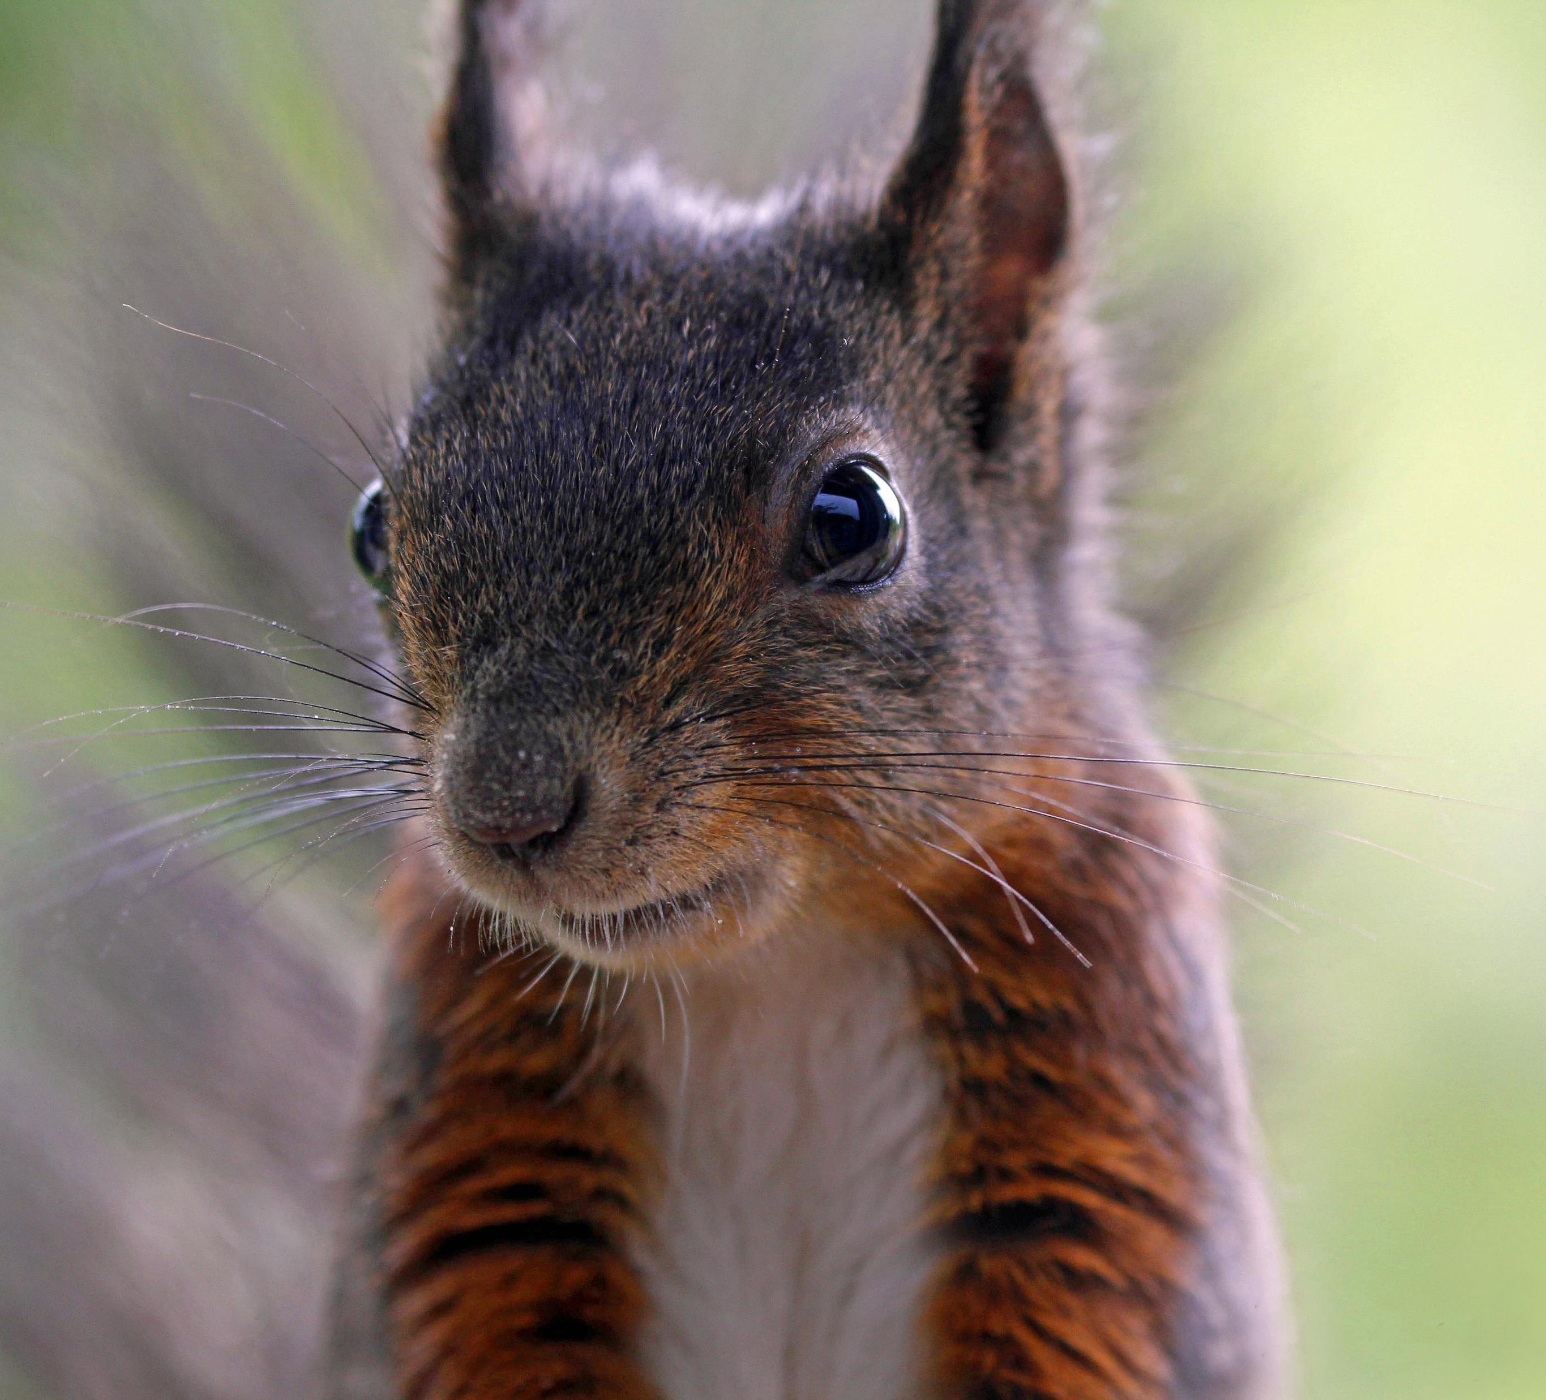
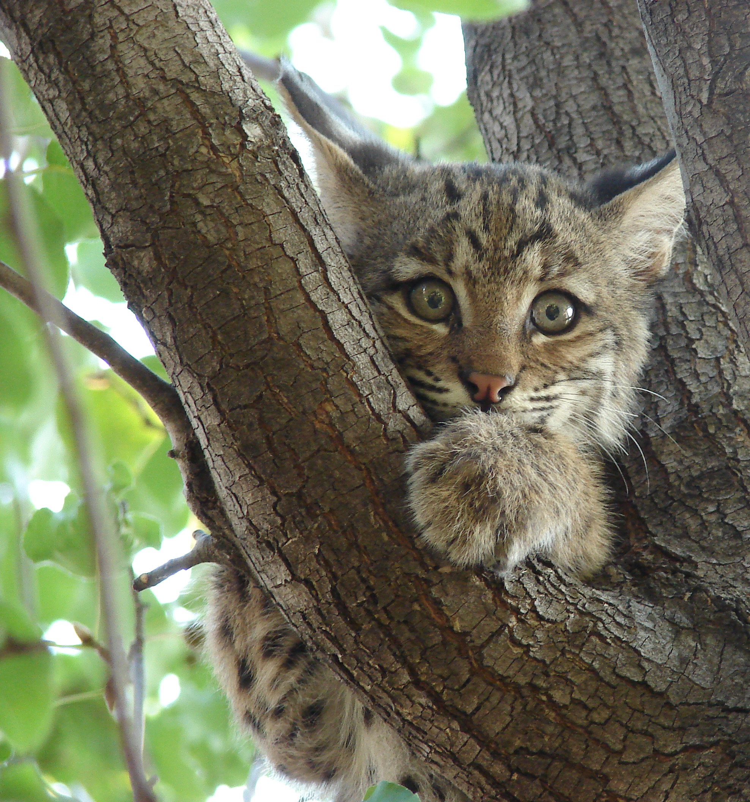
What the Forest Provide

Slide 17
Habitat requirements
Food
Many wildlife species are herbivores and need sufficient plant growth to provide nutrients.
Cover
All wildlife require cover for nesting or protection purposes.
Different cover found in different forest layers.
Even dead trees provide cavities for rodents, birds and other small animals.

Slide 18
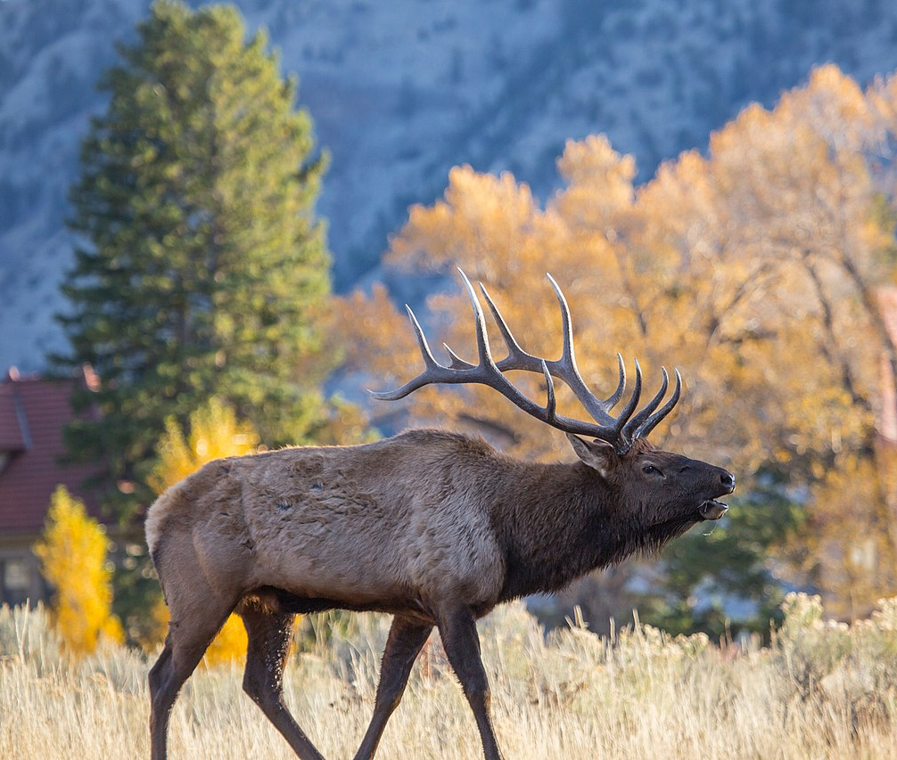
Habitat Requirements
Space
Each species has their comfortable home range. Having enough space to keep species comfortable is important in keeping them around.
Water
Essential for the survival of all living things. Small ponds provide wetland habitat.
Running water provides species with water even when snowfall is heavy and
This Photo by Unknown Author is licensed under CC BY-SA

Slide 19
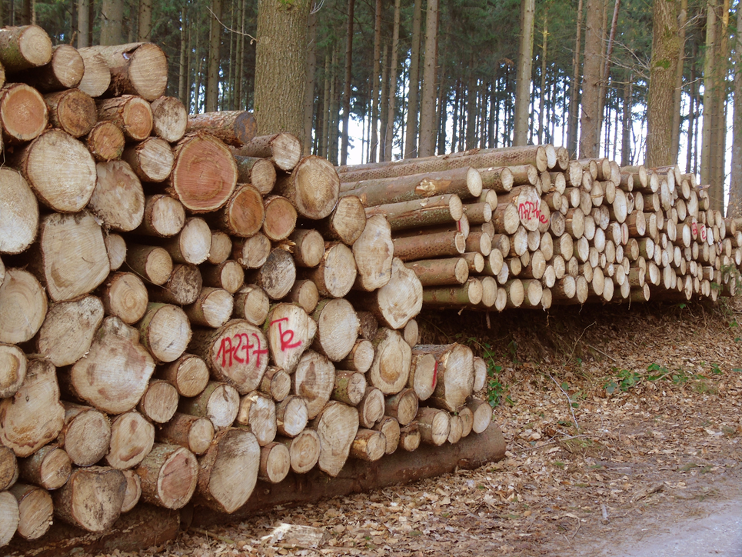
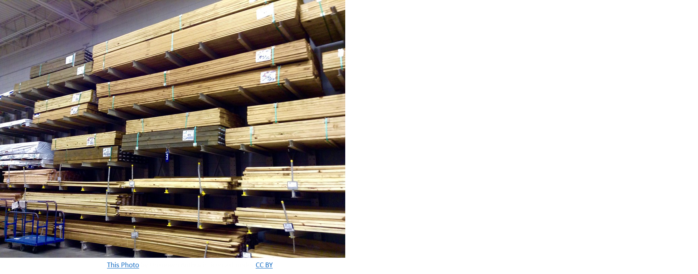
Construction use
The Average home ranges from 1,200 to 2,000 square feet.
2019, 140 Million homes in America.
1 “Board Foot” equals 1” by 12” by 12”
Every 16ft Log may contain 30-40 Board Feet.
1,200 x 140m = 168 Billion Board Feet
5.6 Billion Logs needed.

Slide 20
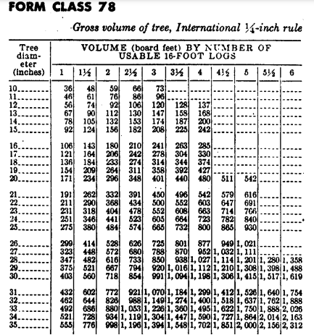
Measuring Volume of a tree
1 log = 16ft
What is the volume of a tree with a Length of 48 and diameter of 18in.
What is the Volume of a tree with a 16ft length and 14in Diameter.
64ft length by 22in diameter.

Slide 21
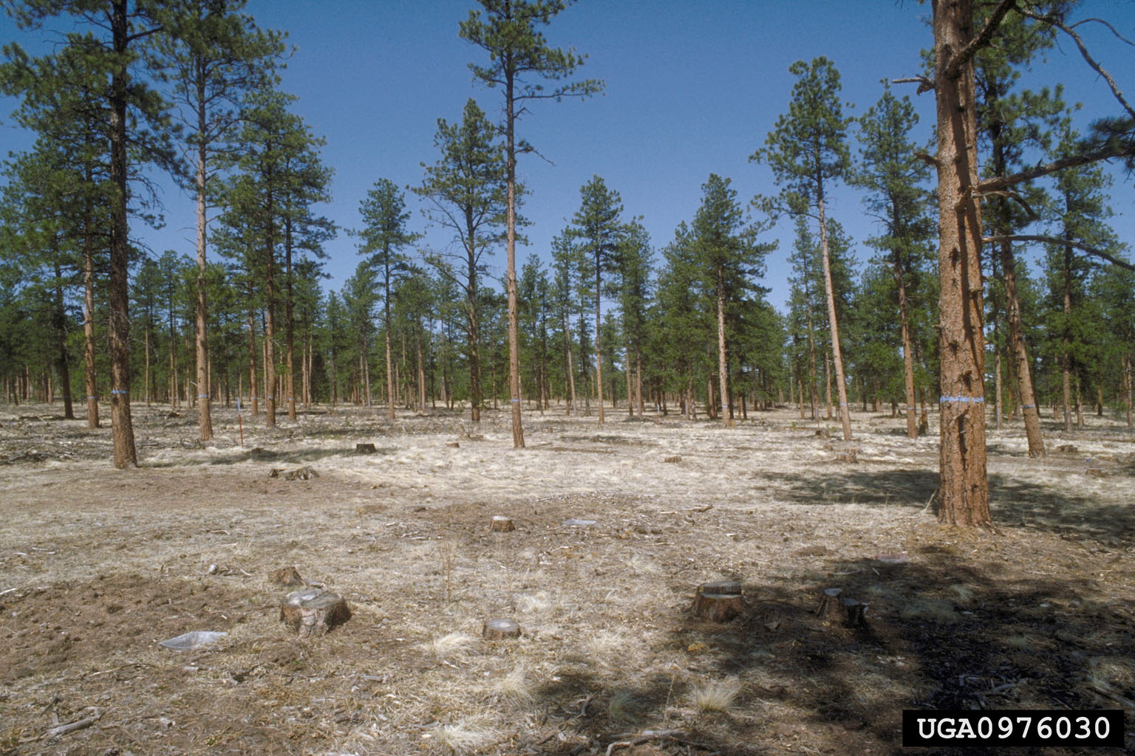
Forest Management/ Types of Harvest
Diameter Limit Cut- Harvest of all trees over specific diameter. Not good for forest regeneration.
Shelterwood Cut- Cutting trees which are out competing/ sheltering multiple smaller trees.
Seed Cut: Removal of trees that are prohibiting new generation. Entire cut tailored to regeneration.
Clearcut- Cutting essentially all trees.
Overstory removal- Cutting away canopy to allow sunlight for new generation below.

Slide 22
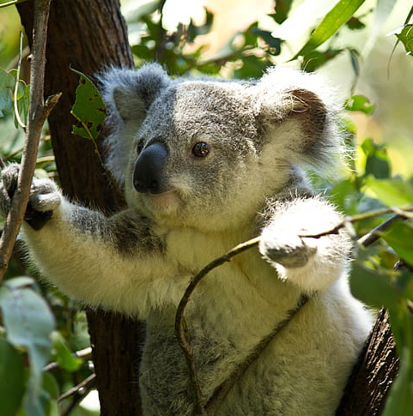
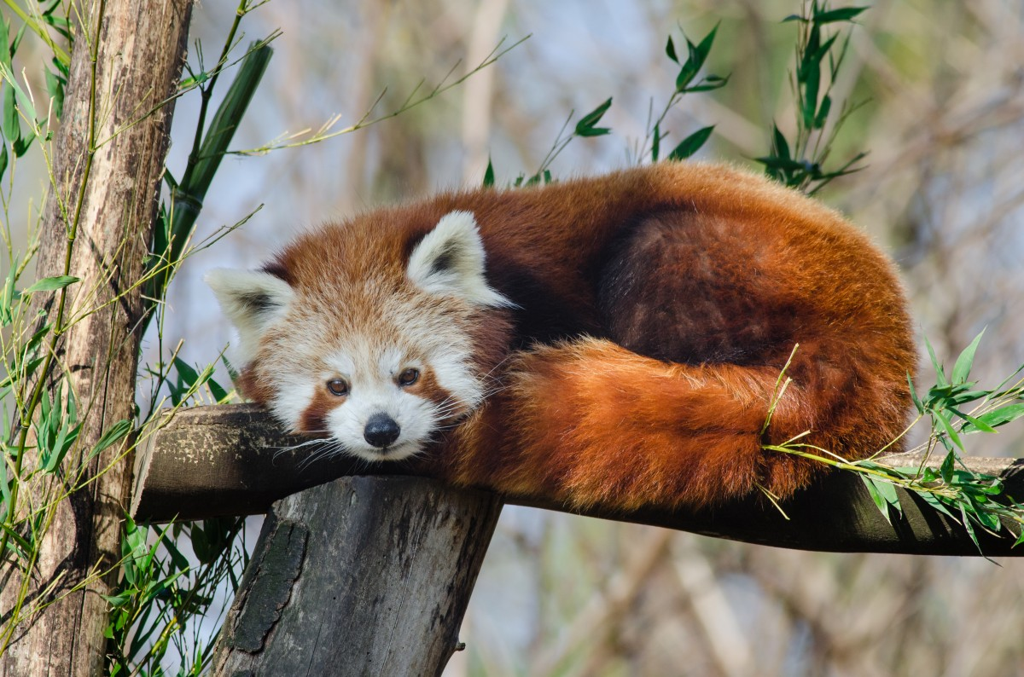
Conclusion
Wildlife
Interactions between the forest and wildlife are connected.
Better forest structure gives you more diverse wildlife.
More diverse wildlife gives you better structure.
Diverse wildlife is a sign of healthy ecosystems.
4 Main types of PA Forest
Northern Hardwoods.
Oak Forest, occupy most ranger in PA.
Great Lakes Beech Sugar Maple.
Mixed Mesophytic
Forest Structure from the bottom up.
Forest Floor
Herbaceous Layer
Shrub Layer
Understory
Canopy
Emergent
One Board Foot 1”-12”-12”
One log 16ft
PA Forest are stable and growing older.
This Photo by Unknown Author is licensed under CC BY

